Slide 1


Babble Labble: Training Classifiers with Natural Language Explanations
Braden Hancock, Paroma Varma, Stephanie Wang, Martin Bringmann, Percy Liang, Chris Ré
ACL
17 July 2018
Melbourne, Australia

Slide 2
Machine learning can help you!***
***If you have enough training data
Notes:
As I’m sure you all know, in most real-world applications today, the question on practitioners minds is not “should my neural network have 4 layers or 5 layers?”
Far more often, the quality bottleneck comes way before that as they find themselves wondering: “how am I going to get enough training data?”

Slide 3
Traditional Labeling
Example
Tom Brady was spotted in New York City on Monday with his wife Gisele Bündchen amid rumors of Brady’s alleged role in Deflategate.
Label
Is person 1 married to person 2?
Y
N
Time Spent
Reading/Understanding
Clicking Y/N
Notes:
So let’s consider for a moment where most datasets come from.
Throughout this presentation I’ll use a running example of a relation extraction task:
We are given a sentence from the news with two people highlighted and we want to train a model to classify whether or not person1 and person2 are married.
The typical approach for a task like this is to have a human view each example individually, read it, understand it, then provide a label.
[reveal pie chart]
But the bulk of the user effort is spent reading and understanding the example, not clicking Y/N;
So after all that effort, all we get is a yes or no, a binary label, a single bit of information.

Slide 4
Higher Bandwidth Supervision
Example
Tom Brady was spotted in New York City on Monday with his wife Gisele Bündchen amid rumors of Brady’s alleged role in Deflategate.
Label
Is person 1 married to person 2?
Y
N
Explanation
Why do you think so?
Because the words “his wife” are right before
person 2.
Notes:
So given that the user has already gone through the effort to understand this example well enough to label it, we would like to collect a bit more information from each example, and in a richer format than just a label.
For example, the user could explain why they labeled it the way they did, in natural language.
This allows the user to convey information in a much higher bandwidth way than with individual labels.

Slide 5
Explanations Encode Labeling Heuristics
Explanation
Why did you label True?
Because the words “his wife” are right before
person 2.
Label
Example
True
“Barack batted back tears as he thanked his wife, Michelle, for all her help.”
True
“Both Bill and his wife Hillary smiled and waved at reporters as they rode by.”
True
“George attended the event with his wife, Laura, and their two daughters.”
Big Idea: Instead of collecting labels, collect labeling heuristics (in the form of explanations) that can be used to label more examples for free.
1 Explanation = Many Labels
Notes:
And we can view each of these explanations as encoding a heuristic for how to label new examples.
For instance, the given explanation which we’ve already collected also applies to these three new examples, which we get labels for “for free” since we now know _why_ that last example got its label and can reapply that logic.
[click]
So the big idea is that instead of collecting labels, we’re going to collect labeling heuristics (in the form of explanations).
If we gave enough of these explanations to a human, along with a bunch of unlabeled data, he or she could essentially label a training set for you, using your own heuristics.
Instead, we’re going to give the explanations to the computer, and have it create our training set for us.

Slide 6
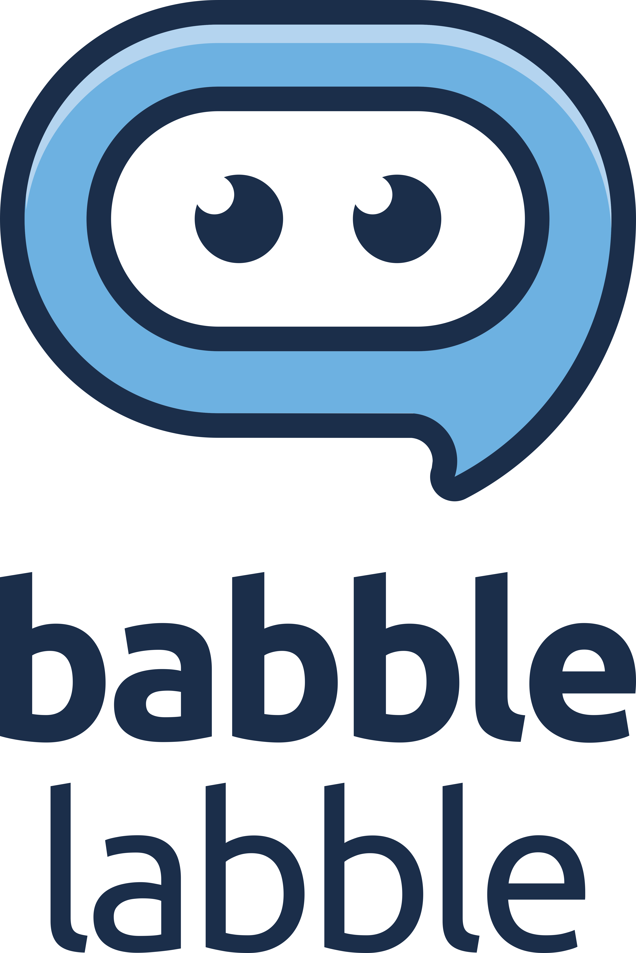
A framework for generating large training sets from natural language explanations and unlabeled data
Result: classifiers trained with Babble Labble and explanations achieved the same F1 score as ones trained with traditional labels while requiring 5–100x fewer user inputs
Notes:
So to be concrete, in our paper, we propose Babble Labble:
A framework for generating large training sets from natural language explanations and unlabeled data.
[click]
And our main quantitative result was that we found that we could train classifiers with the same F1 score using 5-100x fewer user inputs when we collected explanations from users instead of just labels.

Slide 7
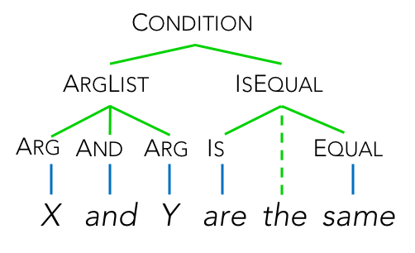
Babble Labble Framework
x₁
x₂
x₃
SEMANTIC PARSER
UNLABELED
EXAMPLES
e₁
True, because…
e₂
True, because…
e₃
False, because…
EXPLANATIONS
Notes:
We’ll now take a closer look at the individual components of the Babble Labble framework, and then present our experimental results.
So I’ve already mentioned the inputs to the system: unlabeled examples, and natural language explanations.
The first component of the framework then is the semantic parser.

Slide 8
Explanations Encode Heuristics
Explanation
Why did you label True?
Because the words “his wife” are right before person 2.
Labeling Function
def f(x):
return 1 if (“his wife” in left(x.person2, dist==1))
else 0 #abstain
Notes:
The purpose of our semantic parser is to convert our labeling heuristics from natural language explanations into executable _labeling functions_.
A labeling function in our case is simply a small Python function that takes as input an example ”x” and outputs either a label, (in this case, 1) or abstains.

Slide 9
Semantic Parser
LF
CONDITION
BOOL
ARGLIST
ISEQUAL
START
LABEL
FALSE
BECAUSE
ARG
AND
ARG
IS
EQUAL
STOP
<START> label false because X and Y are the same person <STOP>
Lexical Rules
Unary Rules
Compositional Rules
Ignored token
→ LF
→ CONDITION
→ ARGLIST
<START>
label
false
→ START
→ LABEL
→ FALSE
FALSE
TRUE
INT
→ BOOL
→ BOOL
→ NUM
START LABEL BOOL BECAUSE CONDITION STOP
ARGLIST ISEQUAL
ARG AND ARG
Labeling Function Template:
def LF(x):
return [label] if [condition] else [abstain]
Notes:
To actually create our parses, we start with the input sentence [click] and a static set of about 200 substitution rules like these; basically a context-free grammar.
Then our substitution rules are applied repeatedly until we’ve identified all the ways a given input could be interpreted to produce a valid labeling function.
This is pretty much just your standard rule-based parsing algorithm.
[click]
And the labeling functions that we build will always follow the same template:
Return [a certain label] if [the given condition holds] otherwise [abstain].

Slide 10
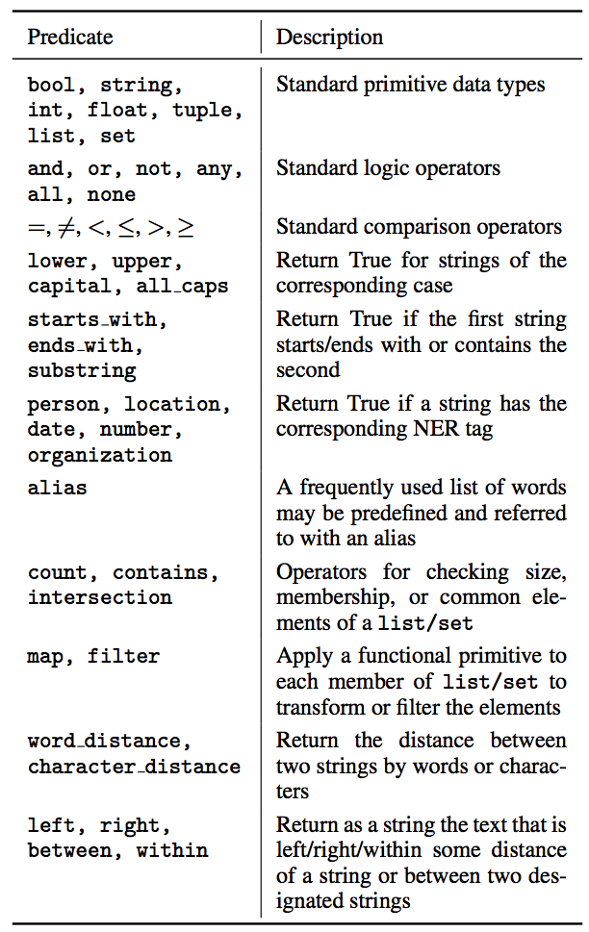
Predicates
Logic & Comparison
String Matching
NER Tags
Sets & Mapping
Relative Positioning
Notes:
The predicates supported by our parser are pretty straightforward:
common logic and comparison operators,
string matching,
basic NER tags from an off-the-shelf tagger,
sets and mapping of functions,
relative positioning of words in a sentence
Basically, our function space is a subset of Python, plus a few helper functions.

Slide 11
Semantic Parser I/O
1 Explanation
1 Parse
Typical Semantic Parser
True, because…
def f(x): return 1 if…
Goal: produce the correct parse
1 Explanation
Many Parses
def f(x): return 1 if…
Our
Semantic Parser
True, because…
def f(x): return 1 if…
def f(x): return 1 if…
Goal: produce useful parses (whether they’re correct or not)
Notes:
One way in which our parser _is_ unique is that usually a semantic parser outputs a single parse, and it’s trained to increase the likelihood of it choosing the “correct” one.
In our framework, however, semantic parsing is the not main goal; it’s just a cog in the larger system.
So instead of focusing on producing the “one true” parse, we’re mostly just interested in producing parses (that is, labeling functions) that will be useful for our end task.
[click]
So we allow our parser to produce many potential parses for each explanation, and then downstream we’ll figure out which ones are useful enough to keep.

Slide 12
Babble Labble Framework
x₁
x₂
x₃
SEMANTIC PARSER
FILTER BANK
UNLABELED
EXAMPLES
SEMANTIC
e₁
True, because…
PRAGMATIC
e₂
True, because…
e₃
False, because…
EXPLANATIONS
Notes:
And that brings us to our next component: the filter bank.

Slide 13
Filter Bank
(Filtered)
Labeling Functions
Explanations
Labeling Functions
Filter Bank
def f(x): return 1 if…
True, because…
def f(x): return 1 if…
def f(x): return 1 if…
Semantic Parser
def f(x): return 1 if…
False, because…
def f(x): return 1 if…
True, because…
def f(x): return 1 if…
def f(x): return 1 if…
def f(x): return 1 if…
def f(x): return 1 if…
Semantic Filter
Pragmatic Filter
Notes:
Recall that we started with a certain number of explanations.
Then the semantic parser produced an even larger number of potential labeling functions.
The role of the filter bank now is to prune down that set as much as possible, removing any labeling functions that we can tell aren’t useful for our task.
And we do this using two types of filters---semantic and pragmatic.

Slide 14
Semantic Filter
Example
x1:
Tom Brady was spotted in New York City on Monday with his wife Gisele Bündchen amid rumors of Brady’s alleged role in Deflategate.
Explanation
True, because the words “his wife” are right before person 2.
Candidate Labeling Functions
“right before” = “to the right of”
“right before” = “immediately before”
def LF_1b(x):
return (1 if “his wife” in
right(x.person2) else 0
def LF_1a(x):
return (1 if “his wife” in
left(x.person2, dist==1) else 0)
LF_1b(x1) == 0
LF_1a(x1) == 1
(“his wife” is not to the right of person 2)
(“his wife” is, in fact, 1 word to the left of person 2)
Notes:
First: the semantic filter.
Because natural language is inherently ambiguous, it’s possible for a single explanation to be interpreted in multiple different ways.
For example, in this explanation, the parser may interpret “right before” as either “to the right of” or “immediately before,” giving us two different candidate labeling functions.
[click]
But, when we apply these functions to this example that they came with, we see that the one on the left is inconsistent, because it abstains on its own example.
From this, we can tell that it clearly doesn’t capture the intended heuristic, so we can go ahead and toss it.

Slide 15
Pragmatic Filters
How does the LF label our unlabeled data?
Uniform labeling
signature
x₁
x_{N}
LF₁:
Duplicate labeling
signature
LF_{2A}:
LF_{2B}:
Notes:
The pragmatic filters, on the other hand, don’t care what you intended;
They’re job is just to remove any labeling functions that we can tell won’t be very useful for making our training set, just by the way they label our unlabeled data.
For example, some labeling functions label all examples True or all False or always abstain. This is clearly not a useful signal.
Others may label the training set identically, either because they are logically equivalent or because they’re so similar that their difference never actually matters when labeling the training set.
In both instances, we can toss the offenders without worrying that we’re losing a valuable signal.

Slide 16
Babble Labble Framework
x₁
x₂
x₃
SEMANTIC PARSER
FILTER BANK
LABEL AGGREGATOR
UNLABELED
EXAMPLES
SEMANTIC
˜
e₁
y
True, because…
PRAGMATIC
e₂
True, because…
e₃
False, because…
EXPLANATIONS
Notes:
The last component of the framework is the label aggregator.

Slide 17
Label Aggregator
x₁
x₂
x₃
x₄
x₅
x₆
x₇
x₈
x₉
LF 1:
Positive
LF 2:
Negative
Input:
LF 3:
Abstain
LF 4:
LF 5:
Output:
˜
y:
?
?
?
?
?
?
?
?
?
Training Data
(x₁,ỹ₁)
(x₂,ỹ₂)
(x₃,ỹ₃)
(x₄,ỹ₄)
Notes:
When we apply all of our surviving labeling functions and apply them to the examples in our unlabeled dataset, we get a matrix like this.
Essentially, each label output by a labeling functions represents a vote for what the training label of that example should be.
[click]
And we now to need to somehow combine these many votes so that we end up with one training label per example, a standard dataset of (x, y) pairs that we can feed to some classifier.
One simple way to combine these votes is to take the majority vote for each example [click] (that is, column by column, pick the most frequent label), and that’s a great baseline.

Slide 18
Label Aggregator
x₁
x₂
x₃
x₄
x₅
x₆
x₇
x₈
x₉
LF 1:
High correlation; not independent?
LF 2:
Input:
LF 3:
LF 4:
High conflict; low accuracy?
LF 5:
Low coverage, high accuracy?
Output:
˜
y:
?
?
?
?
?
?
?
?
?
How should I break this tie?
Data Programming:
(Ratner, et al. NIPS 2016)
As implemented in:
snorkel.stanford.edu
Notes:
But there may be other interesting phenomena in the data, such as correlations between labeling functions, varying accuracies and coverages, or ties among votes.
So we use a more general aggregation technique from our other research called data programming.
Data programming takes all these considerations into account to estimate the true accuracies of the labeling functions and reweight them accordingly when aggregating their votes.
For full details of how that’s done I’ll refer you to the original paper, but the important thing is that at the end of the day, we now have one aggregated label for each example in our dataset.

Slide 19
Babble Labble Framework
x₁
x₂
x₃
SEMANTIC PARSER
FILTER BANK
LABEL AGGREGATOR
DISC. MODEL
UNLABELED
EXAMPLES
SEMANTIC
y
˜
x
˜
e₁
y
True, because…
PRAGMATIC
e₂
True, because…
e₃
False, because…
EXPLANATIONS
Notes:
Now that we have a training set, the final step is to train a discriminative classifier for our task.

Slide 20
Discriminative Classifier
Input: Labeling Functions,
Unlabeled data
Label Aggregator
Discriminative Model
Labeling functions generate noisy, conflicting votes
Resolve conflicts,
re-weight & combine
Generalize beyond the labeling functions
Notes:
You may wonder why we don’t use the label aggregator directly as a classifier, since it does take in new data points and output predicted labels, just like a classifier does.
The motivation for doing this is the same as it is for distant supervision.
Basically, our labeling functions have limited coverage—there may be many examples in our dataset for which no labeling functions fire, but we’d still like to be able to classify them.
So by training a discriminative classifier on our aggregated labels:
we can now generalize and make predictions even for new points that none of our labeling functions voted on
we can take advantage of new features that happen to be helpful for our task, despite not being mentioned in any of our explanations.

Slide 21
Generalization
Task: identify disease-causing chemicals
Keywords mentioned in LFs:
“treats”, “causes”, “induces”, “prevents”, …
Highly relevant features learned by discriminative model:
“could produce a”, “support diagnosis of”, …
Training a discriminative model that can take advantage of additional useful features not specified in labeling functions boosted performance by 4.3 F1 points on average (10%).
Notes:
For a concrete example of this: one task we experimented on was recognizing mentions of chemicals causing certain diseases.
Explanations mentioned words like “treats”, “causes”, “induces”, “prevents”—all very logical signals—but two of the features weighted most highly by the trained discriminative model were the trigrams “could produce a” and “support diagnosis of”
Significantly, neither of these phrases were ever mentioned by the user, but we were still able to take advantage of them.
By using the labeling functions to train a classifier with this larger feature set, we saw an average extra boost of 4.3 F1 points over our three domains (or 10%).

Slide 22
Datasets
Name # Unlabeled Sample Explanations
Spouse 22k
Label true because "and" occurs between X and Y and "marriage" occurs one word after person1.
Disease 6.7k
Label true because the disease is immediately after the chemical and "induc" or "assoc" is in the chemical name.
Protein 5.5k
Label true because "Ser" or "Tyr" are within 10 characters of the protein.
Notes:
For our experiments, we tested on three different relation extraction tasks:
-Spouse: which you’ve seen, where we want to identify mentions of married couples in the news.
-Disease: which I just introduced, identifying mentions of chemicals causing diseases in scientific literature.
-Protein: where we are identifying interacting protein-kinase pairs, again from biomedical literature.

Slide 23
Results
Task | F1 Score | Babble Labble # Explanations | Traditional Labels # Labels | Reduction in User Inputs
Spouse | 50.1 | 30 | 3000+ | 100x
Disease | 42.3 | 30 | 1000+ | 33x
Protein | 47.3 | 30 | 150+ | 5x
Classifiers trained with Babble Labble and explanations achieved the same F1 score as ones trained with traditional labels while requiring 5–100x fewer user inputs
Notes:
So let’s now look at some experimental results.
The result shown in this table is the one I showed a sneak peek of at the beginning of this presentation: we trained classifiers using datasets that were either generated by Babble Labble with 30 explanations or labeled manually with a varying number of labels, and then we found the number of labels where they achieved the same quality.
And it varied by task, but we found that in all three cases, with Babble Labble we were able to achieve the given quality with far fewer user inputs, by a factor of 5 up to 100.

Slide 24
Utilizing Unlabeled Data
With labeling functions, training set size (and often performance) scales with the amount of unlabeled data we have.
Notes:
One reason why those gains are possible is because each user explanation provides potentially many labeled examples from the automatically labeled training set.
You can see here that for all three domains, as we dumped in more unlabeled data, quality went up—by 8 points for Disease up to over 30 for Spouses.
And that’s pretty powerful, because for a lot of domains, data is plentiful—it’s labels that are scarce.
[QUESTIONS]
Why is the red line flatter than the others?
Different tasks have different learning curves.
It’s possible that that’s the most performance boost we could get with those particular 30 explanations, but having more or different labeling functions could take us further.

Slide 25
Filter Bank Effectiveness
Task | Babble Labble (No Filters) | Babble Labble | % Incorrected Parses Filtered
Spouse | 15.7 | 50.1 | 97.8%
Disease | 39.8 | 42.3 | 96.0%
Protein | 38.2 | 47.3 | 97.0%
AVERAGE | 31.2 | 46.6 | 96.9%
The filters removed almost 97% of incorrect parses.
Without the filters removing bad parses, F1 drops by 15 F1 points on average.
Notes:
We also took a look at the effect our filter bank had on end quality.
It turns out that the very simple set of filters we described is rather effective, removing almost 97% of generated “incorrect” parses.
And this makes sense—any parse that made it through the filters had to be based on the user explanation somehow, _and_ label its own example correctly, _and_ label the training set uniquely.
Without the filter bank, F1 score dropped by 15 points on average.
So basically, without the filter bank removing obviously bad labeling functions, we lose the signal in all the noise.

Slide 26
Perfect Parsers Need Not Apply
Task | Babble Labble | Babble Labble (Perfect Parses)
Spouse | 50.1 | 49.8
Disease | 42.3 | 43.2
Protein | 47.3 | 46.8
AVERAGE | 46.6 | 46.8
Using perfect parses yielded negligible improvements.
In this framework, for this task, a naïve semantic parser is good enough!
Notes:
Perhaps because the simple filter bank is so effective, we found that even when we manually converted user explanations into parses, it didn’t really improve final quality.
Now, there are definitely applications where you do need your semantic parser to be as accurate as possible, and using a trained state-of-the-art parser would likely do you no harm.
But, it seems that for our tasks and in this framework, it was enough to just generate a large pool of potential parses and pass them downstream.

Slide 27
Limitations
“Alice beat Bob in the annual office pool tournament.”
Do you think person 1 is the spouse of person 2? Why?
No, because it sounds like they’re just co-workers.
Prefers
High-level
(e.g., “it says so”)
Prefers
Low-level
(e.g., keywords,
word distance, capitalization, etc.)
What’s a co-worker?
Users’ reasons for labeling are sometimes high-level concepts that are hard to parse.
Notes:
There are some limitations to this approach:
One is that users’ reasons for labeling are sometimes high-level concepts that are hard to parse, like this example.
If we show the users the list of valid primitives, that helps to some extent, but there will still always be concepts that the user would like to refer to that you don’t have a good way to convert into functions.
Fortunately, explanations are pretty inexpensive to collect, so we’re not too concerned if we end up needing to toss some of them, so long as we can collect _some_ parseable explanations.
I also think this is an interesting direction for future work—perhaps we could use a different kind of model to convert the natural language into weak labels, such as a pre-trained open information extraction model, or a question answering model.
We should also note that so far this has only been tested on relation extraction; it’s possible other issues would arise in other kinds of tasks.

Slide 28
Related Work: Data Programming
Common theme:
Use weak supervision (e.g., labeling functions) to generate training sets
Snorkel (Ratner et al., VLDB 2018)
Flagship platform for dataset creation from weak supervision
Structure Learning (Bach et al., ICML 2017)
Learning dependencies between correlated labeling functions
Reef (Varma and Ré, In Submission)
Auto-generating labeling functions from a small labeled set
snorkel.stanford.edu
Notes:
In terms of related work, the biggest one is other work from our lab with Data Programming.
In a number of projects over the past couple of years, we’ve seen that using labeling functions can give us much more efficient and scalable supervision than hand-annotated labels.
Babble Labble is the first to consider a natural language interface, but these are some of the other related projects:
Snorkel – This is our most well-known system, one that I’m actively involved with, and it accepts labeling functions written directly in Python code. This is what Babble Labble calls under the hood after parsing the explanations.
Structure Learning – where we showed that you can automatically learn dependencies between correlated labeling functions (and take that into account as you estimate their accuracies)
3) Reef – a paper currently under review (but available online as a tech report) where we use a small labeled seed set to _automatically_ synthesize new labeling functions
You can find links to these and a bunch of other papers at snorkel.stanford.edu.

Slide 29
Related Work: Explanations as Features
(Srivastava et al., 2017)
What if we use our explanations to make features instead of training labels?
DISC. MODEL
Use as
features for classifier
x₁
x₂
x₃
x₄
x₅
x₆
x₇
x₈
x₉
y
Exp 1:
x
˜
Exp 2:
Exp 3:
Exp 4:
LABEL AGGREGATOR
DISC. MODEL
Exp 5:
y
˜
x
˜
y
Use as labels for
training set
Using the parses to label training data instead of as features boosts 4.5 F1 points.
Notes:
Another related work that we compared to in our paper was some very cool work from Carnegie Mellon by Srivastava, et al. where they _jointly_ trained a semantic parser and a linear classifier.
They make a similar matrix to ours by applying their parsed explanations to individual examples.
But then, whereas we used this matrix to create a training set, they use it directly as a feature matrix for the classifier.
And this can work really well sometimes, since you’re essentially doing custom feature engineering, just via natural language explanations.
But we found that when we use these explanations to label a training set instead, we can then benefit from those boosts we saw earlier, like using unlabeled data to give us a larger training set, or taking advantage of a larger feature set.

Slide 30
Related Work: Highlighting
Highlight key phrases in text:
(Zaidan and Eisner, 2008), (Arora and Nyberg, 2009)
Mark key regions in images:
(Ahn et al., 2006)
Label key features directly:
(Druck et al., 2009), (Raghavan et al., 2005), (Liang et al., 2009)
Tom Brady was spotted in New York City on Monday with his wife Gisele Bündchen amid rumors of Brady’s alleged role in Deflategate.
Benefits of natural language approach:
more options: e.g., “X is not in the sentence”, “X or Y is in the sentence”
more direct credit assignment (compared to highlighting)
no feature set required a priori
Notes:
And finally, there have been a number of other proposed approaches for how to get more bang for your buck from labels, often by identifying particularly relevant parts of the input.
These included highlighting key phrases in text, marking key regions in images, or labeling key features directly.
But there are a few reasons why we may choose to stick with a natural language interface instead, such as:
More options. There are certain types of patterns that you actually can’t identify using just highlighting, such as the absence of certain words, or the presence of _at least one_ word
We can give more direct credit—for example, if the phrase ‘his wife’ is important, is that because it always is, or only because it’s right next to person2, or because it’s in the same sentence as Tom Brady? We don’t really know with highlighting, but an explanation specifies this.
Because our explanations aren’t tied to specific features, we can use the same supervision with a variety of feature sets, including representation learning if we’re using a neural network, for example.

Slide 31
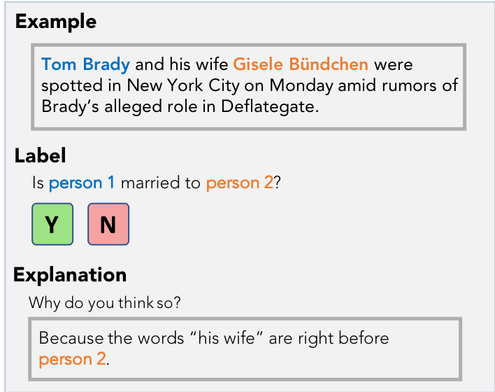
Summary
We need more efficient ways to collect supervision
We can collect labeling heuristics instead of labels
Using this approach, training set size grows with the amount of unlabeled data we have
https://github.com/HazyResearch/babble
Babble Labble is open source and available for tinkering!
Notes:
So in summary:
1) There is a growing need for training data to feed our data-hungry models, and labeling in a traditional way leaves a lot of signal on the table
2) We find that by collecting labeling heuristics (in this case, in the form of natural language explanations), we’re able to more efficiently generate large labeled training sets.
3) With this approach, training set size grows with the amount of unlabeled data we have, which allows for improvements in performance to be made without requiring additional user annotations.
The result is a much more efficient way to get supervision from a human into a model, using just a natural language interface.
And our code will be posted shortly following ACL on github.
Thank you very much for listening!

Slide 32
EXTRA SLIDES

Slide 33
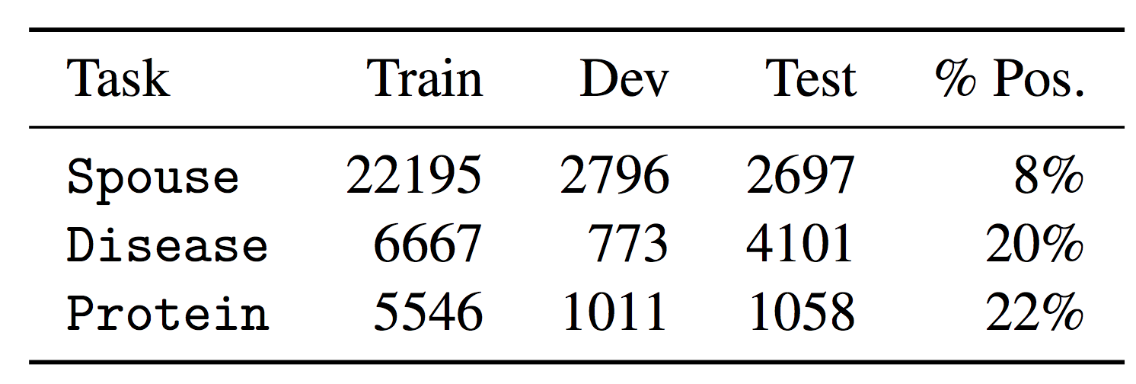
Dataset Statistics

Slide 34
Babble Labble Framework
Notes:
To make this more concrete, here’s a figure from our paper showing the workflow with some examples:
In a large unlabeled dataset, the user provides explanations for a few of them.
These are parsed into Python labeling functions, and our filter bank removes some of them.
Those that survive the filters go on to label the entire unlabeled dataset, and we aggregate those labels to form our final set of x’s and y’s that we train a model with.

Slide 35
Babble Labble Framework
INPUT
SEMANTIC PARSER
FILTER BANK
LABEL AGGREGATOR
DISC. MODEL
x₁
x₂
SEMANTIC
y
˜
x
˜
y
x₃
PRAGMATIC
UNLABELED
EXAMPLES
e₁
True, because…
LF_{1A}
x₁
x₂
x₃
e₂
LF_{1B}
1 | 0 | 1
0 | -1 | -1
x₁
x₂
x₃
True, because…
LF_{1B}
˜
LF_{3A}
y
+ | - | +
e₃
False, because…
LF_{3A}
EXPLANATIONS
LABELING FUNCTIONS
LABEL MATRIX
PROBABILISTIC LABELS
TRAINED MODEL
IMPORTANT: No Babble Labble components require no labeled training data!
Notes:
Here I’ll introduce the primary components of the Babble Labble Framework, with their inputs and outputs, and then in the following slides we’ll go into each one in more detail.
The inputs from the user are explanations and a whole bunch of unlabeled data.
The semantic parser converts these explanations into labeling functions.
Because natural language is inherently ambiguous, we sometimes end up with multiple valid parses (or functions) for a given explanation.
The filter bank applies a couple of types of filters to remove the majority of these incorrect functions.
The remaining functions are applied to all examples in the unlabeled dataset, giving us this label matrix with multiple noisy labels per example.
Because we now have multiple labels for each example, the label aggregator combines these into a single probabilistic label for each example.
From this, we now have the (x’s and y’s), data points and auto-generated labels with which to train the model we ultimately care about.
*Importantly, none of these components require any labeled training data, making this framework able to be used pretty much “out of the box” on new domains.

Slide 36
Babble Labble
Example
Label Matrix
Tom Brady was spotted in New York City on Monday with his wife Gisele Bündchen amid rumors of Brady’s alleged role in Deflategate.
x₁
x₂
x₃
x₄
…
LF₁
1
LF₂
-1
Label
Is person 1 married to person 2?
LF₃
-1
-1
Y
N
LF₄
1
1
1
…
Explanation
Why do you think so?
Aggregated Labels
Because the words “his wife” are right before
person 2.
ỹ
+
-
-
+
…
Classifier
(x₁,ỹ₁)
(x₂,ỹ₂)
(x₃,ỹ₃)
(x₄,ỹ₄)
Labeling Function
x
ỹ
def LF1(x):
return (1 if “his wife” in left(x.person2, dist==1)
else 0)
Notes:
Applying many such labeling functions to a large unlabeled dataset gives us a matrix of votes for how those examples should be labeled.
Using some of our other work on combining weak supervision sources, we are able to intelligently reweight and aggregate these noisy labels to form a single probabilistic label per example, which can then be used to train a classifier.
We’ll go into each of these components in greater detail in the coming slides, but this is the high-level picture:
Explanations to labeling functions, labeling functions to many approximate labels per data point, and then aggregating these intelligently to form our training set for a final classifier.

